Slide 1
Analysis on DEF 14 A Filings of YAHOO
ILLINOIS INSTITUTE OF TECHNOLOGY School of Applied Technology
Group 6
Presented By:
Akshay Srinivasan
Esha Ghosh
Gaurav Jhaveri
Radhika Gupta
Preethi Thesinghraja
ITM - 527

Slide 2
ILLINOIS INSTITUTE OF TECHNOLOGY School of Applied Technology
TABLE OF CONTENT
Title | Slide Number
Introduction | 3
Salary of the CEO’s for each year of YAHOO | 4
Stock awards of the CEO’s for each year of YAHOO | 5
Option awards of the CEO’s for each year of YAHOO | 6
Salary and compensation for the CEOs of Yahoo for all the available year | 7
Highlights on stock trend before and after the filing date for 2015 | 8
Stock trend analysis for the year 2012 – 2015 | 9
Key Event Indicator 1 - Share | 10
Key Event Indicator 2 - Annual | 11
Word Cloud for the top 10 words | 12
Exception KEIs for Q&A section | 13
Title | Slide Number
Most Frequent words in Q&A section | 14
Gradual decrease for word frequency for DEF 14 A filings | 15
ITM - 527

Slide 3
ILLINOIS INSTITUTE OF TECHNOLOGY School of Applied Technology
INTRODUCTION
INTRODUCTION
Yahoo is an American based multinational company, having its headquarters in Sunnyvale, California.
Yahoo was founded in January, 1994 by Jerry Yang, David Filo.
Current CEO (Chief Executive Officer) of Yahoo is Marissa Mayer.
In October 2005, Alibaba Group took over the operation of China Yahoo! as part of its strategic partnership with Yahoo! Inc.
Yahoo grew rapidly throughout the 1990s and diversified into a web portal, followed by numerous high-profile acquisitions.
Yahoo offers different types of products like Yahoo news, mail, Finance, Sports, Search, Messenger, Answers, Tumblr, Flickr, having total asset of US $45.20 billion and equity shares of US$29.04 billion and a revenue of US$4.96 billion.
Yahoo provides small services such as Yahoo Domain Keys, Yahoo Web Hosting, Yahoo Merchant Solutions, Yahoo Business Email and Yahoo Store etc.
ITM - 527

Slide 4
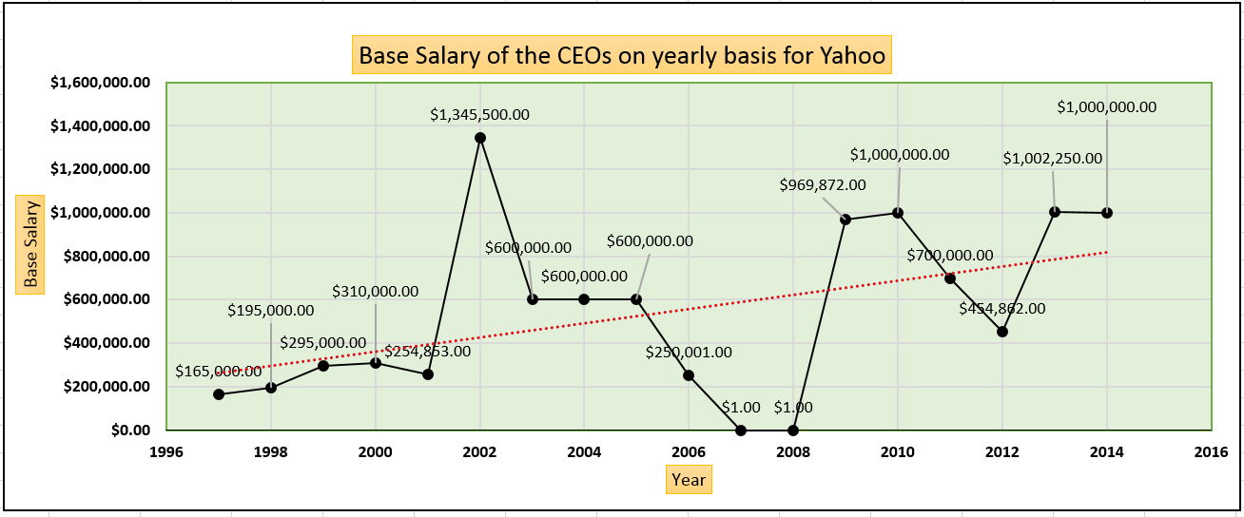
ILLINOIS INSTITUTE OF TECHNOLOGY School of Applied Technology
Salary of the CEO’s for each year of YAHOO
ITM - 527

Slide 5
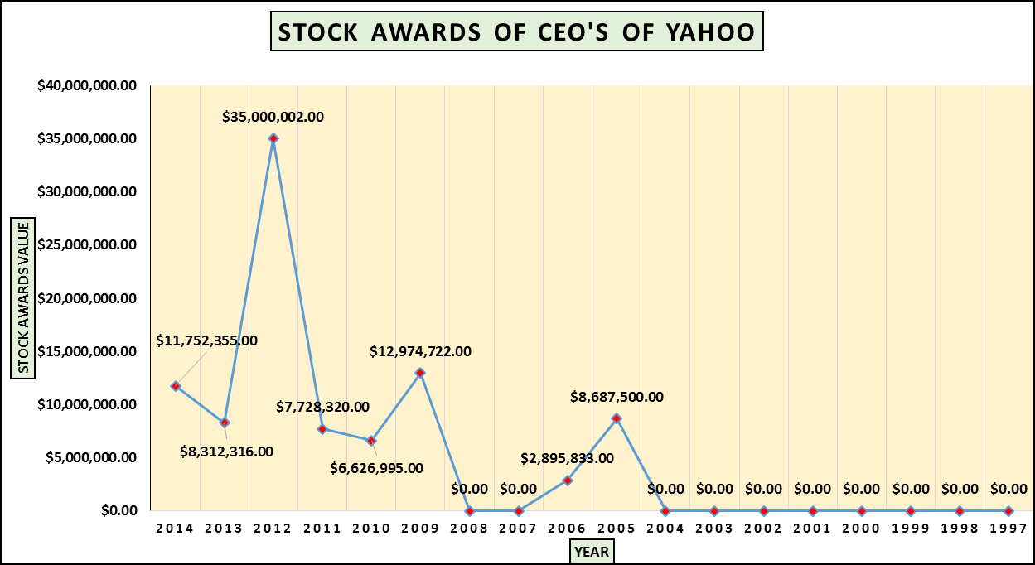
ILLINOIS INSTITUTE OF TECHNOLOGY School of Applied Technology
Stock awards of the CEO’s for each year of YAHOO
ITM - 527
Years, 2012 to 2015 marked under the governance of Marissa.A.mayer , has a significant and consistent rise in stock value and a consistent salary of the CEO, which signifies a profit of the shareholders ,leading to an increase in the Stock Awards, with the highest lying in the year 2012
Alibaba paid Yahoo $7.6 billion to buy back a relatively small portion of that stake. Yahoo took that money and started buying Yahoo stock with it. This drove up the price and hence created a provision for an increased the stock awards

Slide 6
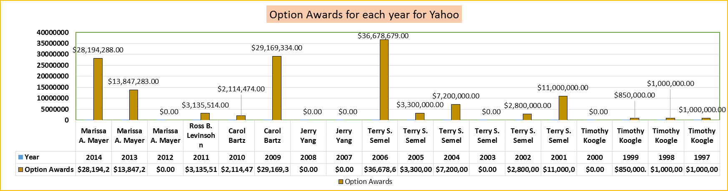
ILLINOIS INSTITUTE OF TECHNOLOGY School of Applied Technology
Option awards of the CEO’s for each year of YAHOO
ITM - 527
Like stock compensation, performance cash bonuses jumped in the year 2006 as a result of the surging stock market and higher corporate profits. Earnings per share rose 5.3 percent in 2013, according to Fact Set. That resulted in a median cash bonus of $1.9 million, a jump of 12.6 percent from the prior year.
In 2009, there was an abrupt decrease in the stock value, and yet the option awards for that year was high. The salary of CEO was also high in that year.
In the year 2007, option awards sum up to zero, this adds up nothing to the salary of the CEO. The CEO s salary is also zero.

Slide 7
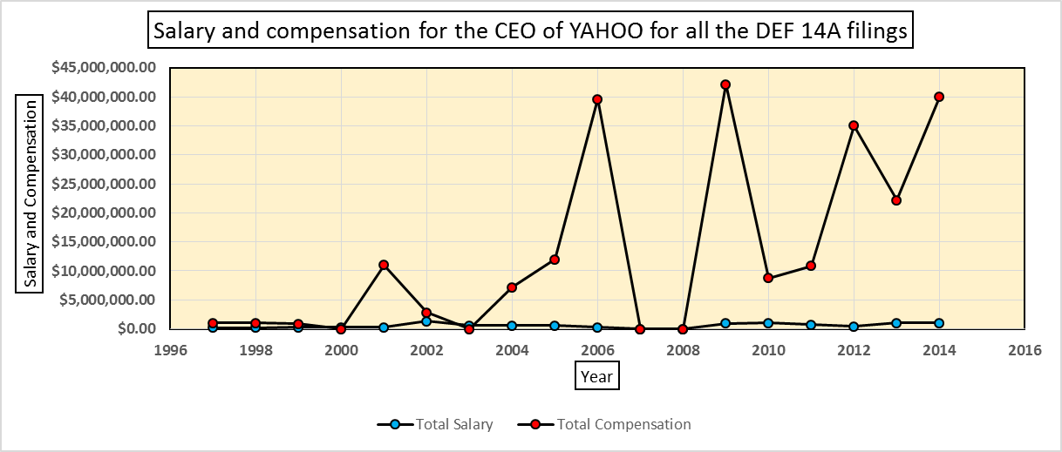
ILLINOIS INSTITUTE OF TECHNOLOGY School of Applied Technology
Salary and Compensation for the CEO of YAHOO for all the DEF 14A Filings
ITM - 527
If we assume the fact that the CEO’s salary include stocks as a compensation, then the above graph shows selling of those stocks in most of the years.
However, in 2000, 2007, and 2008 his compensation is same as his salary which means those years he did not sell any stocks given to the CEO for that particular year.

Slide 8
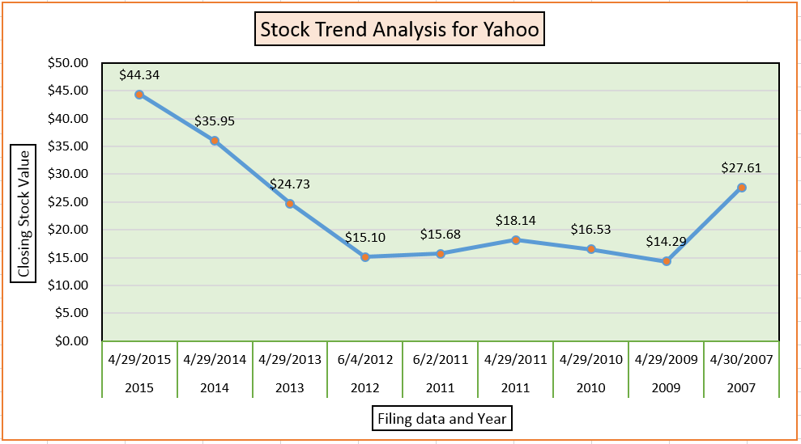
ILLINOIS INSTITUTE OF TECHNOLOGY School of Applied Technology
Highlights on Stock Trend before and after the filing date for 2015
2007 marked as Jerry yang time, has a closing stock value of 27.61 $, has the least CEO Salary that year but in 2 years, It marks a drop in the closing stock value to 14.29 $, which is almost 50 percent but had the CEO salary increasing. This period indicates a decrease in the shareholder's profit
In 2011, the filing was done twice and has a decrease in the stock value but increases when compared to the previous year 2010.
ITM - 527
2012 to 2015 marked under the governance of Marissa.A.Mayer , has a significant and consistent rise in stock value and a consistent salary of the CEO, which signifies a profit of the shareholders a.k.a investors.
The stock has nearly tripled in value since Ms. Mayer was hired as their CEO, rising from $15.65 on July 16, 2012 (her hire date) to $44.13 on April 1, 2015.

Slide 9
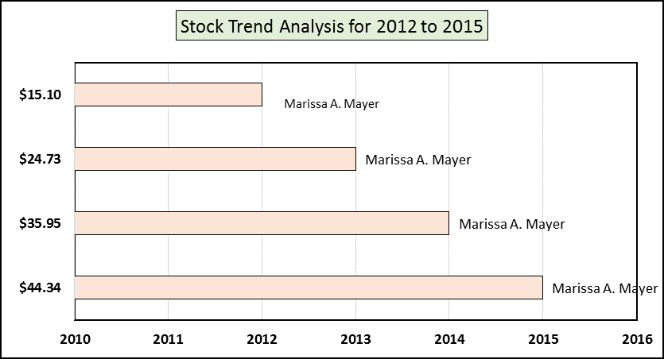
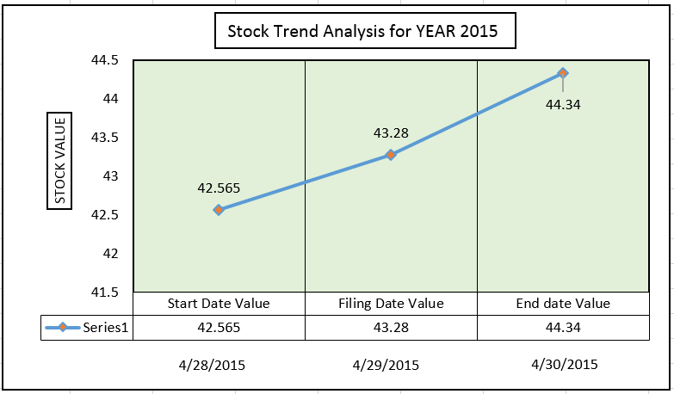
ILLINOIS INSTITUTE OF TECHNOLOGY School of Applied Technology
Stock Trend analysis for the years 2012 – 2015 - YAHOO
The Trend Analysis shows the variation of the stocks with start date, filing date and the End dates for the year 2015.
As we plot the stock value corresponding to the
- Start date( one day previous to the filing date)
- Filing Date
- And the end Date ( one day prior to the filing date), we can see an corresponding increase in the stock value. This also shows that the market fluctuations to quantify the financial impact of an SEC filing in the year 2015
Building Shareholder Value
Besides re-investing in the business, during 2014 they returned approximately $4.2 billion to their shareholders through stock repurchases.
Yahoo’ stock price has increased 182 percent since Ms. Mayer was hired on July 16, 2012, from a closing price of $15.65 that day to $44.13 on April 1, 2015.
With approximately 1.2 billion shares of Yahoo common stock outstanding on July 16, 2012 and approximately 937 million shares outstanding on April 1, 2015, these stock price increases resulted in the creation of over $22.7 billion of shareholder value from July 16, 2012 through April 1, 2015.
ITM - 527

Slide 10
ILLINOIS INSTITUTE OF TECHNOLOGY School of Applied Technology
Conclusion – Stock Trend – What is Yahoo really worth?
The Shares were around $15.65 when Marissa Mayer took over and then reached the highest at $52.37 in 2015 before settling down at $36.66 in 2016.
It was obvious of a point that Marissa Mayer, CEO of Yahoo, is the significant role behind on the rise of stock over the past 4 years.
But the pump might not be due to Mayer, it might stem from small investments yahoo made into the two popular ancient companies long before she was hire.
If we take out Alibaba stake, If we take out Yahoo japan stake, if we take the the debts, then the value comes to negative.
ITM - 527
Market Cap | $42.3B
(-) ALIBABA Stake | $22.1B
(-)YAHOO JAPAN Stake | $7.8B
(-) CASH and EQUIVALENTS | $4.3B
(+) DEBT | $1.1B
$8.1
The Alibaba-Yahoo relationship has been strained in recent years and Ma has telegraphed his desire to reduce or buy back Yahoo's stake. "We appreciate yesterday, but are looking for a better tomorrow," Ma told the Stanford audience.
Reference : Bloomberg Analytics

Slide 11
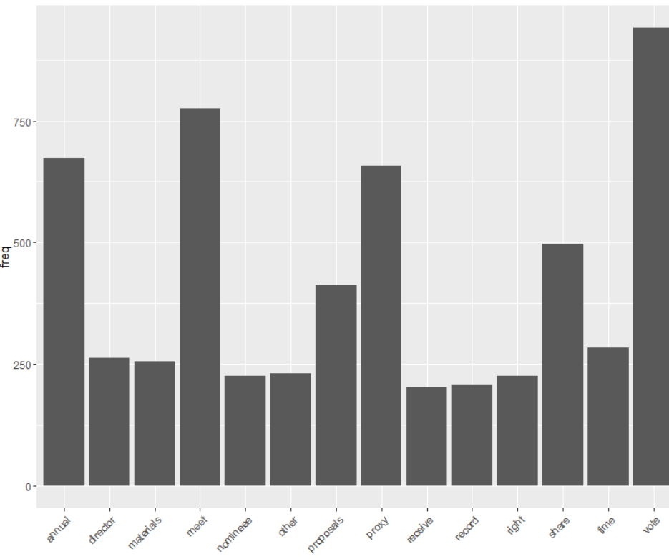
KEY EVENT INDICATOR 1 - Share
ILLINOIS INSTITUTE OF TECHNOLOGY School of Applied Technology
In the following bar graph, the word ‘Share’ is among the top 15 frequently occurring words.
KEI is basically an event in which drastic changes can be visualized within consecutive years.
For Word ‘Share’ in 2005 the frequency count is 57 then it gradually increased to 108 in 2009 and then it suddenly decreased back to 45 in 2011.
Thus due to the continuous fluctuations in the frequency of occurrence, it marks an key indication which may be caused due to the changes in the company’s filing for that particular year.
Thus it is a Share KEI.
ITM - 527

Slide 12
KEY EVENT INDICATOR 1
ILLINOIS INSTITUTE OF TECHNOLOGY School of Applied Technology
KEY EVENT INDICATOR 2 - Annual
In the following bar graph, the word ‘annual’ is among the top 5 frequently occurring words.
For Word ‘annual’ in 2005 the frequency count is 86 then it gradually increased to 149 in 2009 and then it suddenly decreased back to 36 in 2015.
Thus due to the continuous fluctuations in the frequency of occurrence, it marks an key indication which may be caused due to the annual revenue changes and gross income in that company’s filing for that particular year.
Thus it is an Annual KEI.
ITM - 527

Slide 13
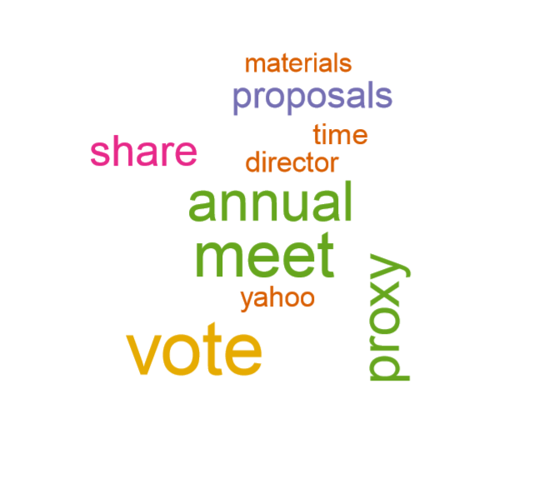
ILLINOIS INSTITUTE OF TECHNOLOGY School of Applied Technology
Word Cloud for the TOP 10 words
The following word cloud visualizes the list of Top 10 most frequently occurring words in the QA section of the DEF 14A Filings.
Here the words “Vote”, “meet” and “Annual” are the top 3 words by frequency of occurrence.
Words such as “Annual” & “meeting” and words “proxy” &“materials” appear in pairs often in the filings.
ITM - 527

Slide 14
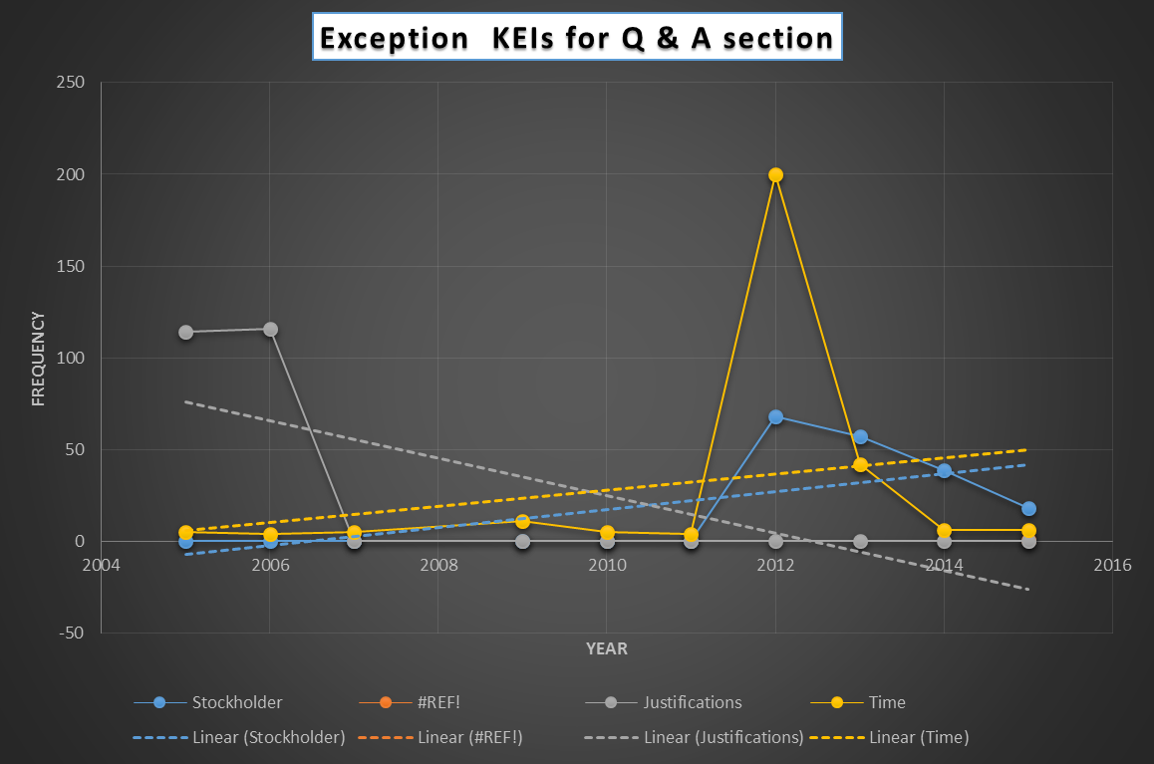
ILLINOIS INSTITUTE OF TECHNOLOGY School of Applied Technology
Exception KEIs for Q&A section
Year | Stockholder | Justifications | Time
2015 | 18 | 0 | 6
2014 | 39 | 0 | 6
2013 | 57 | 0 | 42
2012 | 68 | 0 | 200
2011 | 0 | 0 | 4
2010 | 0 | 0 | 5
2009 | 0 | 0 | 11
2007 | 0 | 0 | 5
2006 | 0 | 116 | 4
2005 | 0 | 114 | 5
Total | 182 | 230 | 288
ITM - 527
1) The word 'Justifications' had 114 and 116 as their frequency for the year 2006 and 2005 but the other years, it was just Zero. It was in 2005 that yahoo started filing the Q & A and may be that is the reason the word justification is used justify for including a Q&A column/section.
2) The word 'Stockholder' was never been used from the years 2005 to 2011 and then from 2012, then from 2012 to 2015 there was a high frequency of the word, it might be for the reason that there was a high increase in stocks from the year 2012 to 2015.

Slide 15
ILLINOIS INSTITUTE OF TECHNOLOGY School of Applied Technology
Most Frequent words in Q & A Sections
1) Vote has the highest frequency i.e. 1065 In the QA corpus. However, On analyzing, we find that it appears anonymously with other words so there cannot be any specific analysis to it.
2) Meet is the second highest appearing word among the corpus. On analysis we find that it is perhaps meetings which appear as Meet.
3) Proxy is among the top words in our list. It generally correlates with the word Material most number of times in the corpus.
4) Annual is among the top 3 words in our list. Similarly, It correlates with meeting most number of times. So ,We conclude that it stresses the fact that is Annual Meeting.
5) We notice that words like proposal, Yahoo, Vote appear anonymously in the QA corpus . However ,These words are the most important words in the corpus for proxy statement.
ITM - 527

Slide 16
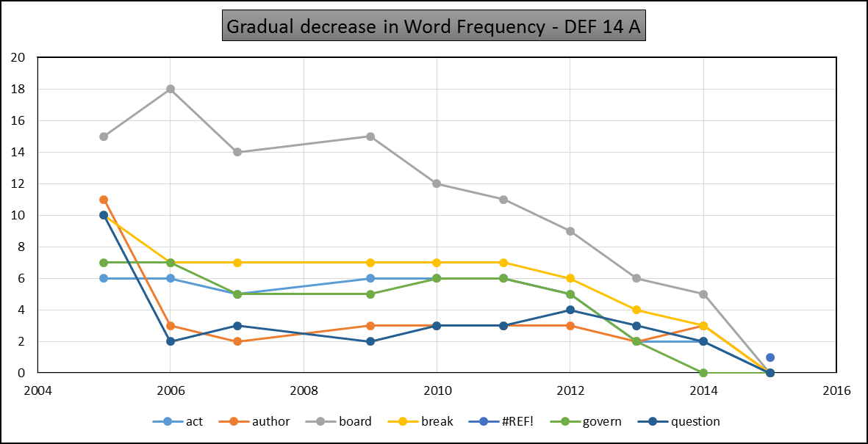
ILLINOIS INSTITUTE OF TECHNOLOGY School of Applied Technology
Gradual decrease for Word Frequency – DEF 14A
1) The word authorized appears as author. Usage of the word Authorized decreases from year 2005 to year 2015. This is because, Yahoo does not use the word 'authorized', instead they use the word 'Representative' from the year 2014.
The frequency of the word 'Board' is decreasing from year 2005 to year 2015. Initial years of filings of DEF 14A, yahoo used the word 'Board' to represent the board of directors. Later they started to use the word 'yahoo' directors.
ITM - 527

Slide 17

QUESTIONS ?
ILLINOIS INSTITUTE OF TECHNOLOGY School of Applied Technology
ITM - 527

